Slide 1

Analysis of IPL (2008-17)
By:- ShubhadIp BHOWMICK Malathi Ramakrishnan Urmila CHAVAN

Slide 2
Agenda
Introduction
Scope and Motivation
Details of Dataset
Key Points Covered
Visualization
Agenda
Cricket, especially the IPL has the maximum uncertainty where a single over can completely change the whole momentum and circumstances of the game.
Doing Sports analysis is the process of collecting past matches data and analysing them to extract the essential and meaningful insights.
Visualisation of this dataset is the key part of our project as it cover lot of factors determining the winner of match.
As the IPL happens every year and is very popular in India therefore analysis
and finding insights can be very useful for publishing articles in newspapers and providing meaningful insights to news channel and other consumes.

Slide 3
Agenda
Introduction
Scope and Motivation
Details of Dataset
Key Points Covered
Visualization
Introduction
The idea is to analyse the IPL to come up with something interesting and useful.
The insights from the dataset can really be helpful for the IFP management provides news reports and feeds to magazines, newspapers and TV broadcasters all over the country.
Handling all the factors like effect of homeground and toss winner is the real world problem.
Interactive Visualization will be used over various modes thus constitutes important factor in this analysis

Slide 4
Agenda
Introduction
Scope and Motivation
Details of Dataset
Key Points Covered
Visualization
Details of Dataset
As a Leading Data Analyst at IFP we have two Datasets matches and deliveries.
The dataset has detailed information about which team won the match by how much margin (wicket or runs depending on the team to opt for batting or bowling).
The dataset has columns telling about the man of match, venue, and the dataset was not sorted on the basis of season so sorting of data was done at beginning.

Slide 5
Agenda
Introduction
Key points Covered
Details of Dataset
Key Points Covered
Visualization
Key Points Covered
1. Match Statistics
Toss outcome vs Match outcome (for each Ground/Venue)
Biggest wins (by runs and by wicket)
Highest totals (across all the seasons)
2. Player Statistics
Orange Cap contenders (The batsmen who have scored the maximum number of runs in a particular season)
Purple Cap contenders (The bowlers who have taken the maximum number of wickets in a particular season)
Batsmen who have hit the most number of fours and sixes (per season and overall)
3. Team Statistics
Season-wise team performance (wins vs losses)
Win %age ( home vs away)

Slide 6
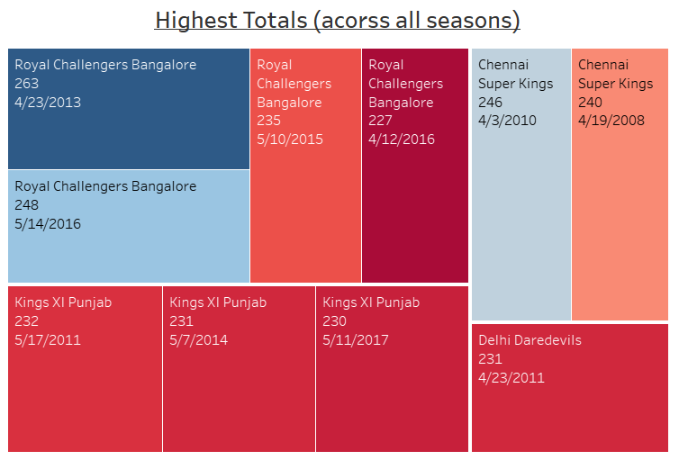
Match Statistics
Agenda
Introduction
Scope and Motivation
Details of Dataset
Key Points Covered
Visualization
Visualization
Insights:
Royal Challengers Bangalore, Chennai Super Kings and Kings XI Punjub are the teams having highest total across seasons.
Royal Challengers holds the record for highest total acorss all seasons.
06/07/23
IPL ANALYSIS

Slide 7
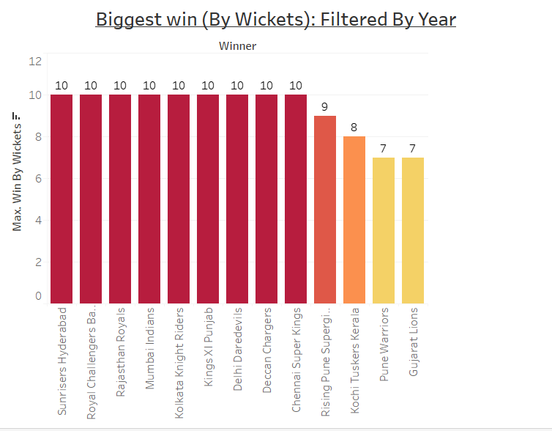
Match Statistics
Agenda
Introduction
Scope and Motivation
Details of Dataset
Key Points Covered
Visualization
Visualization
Insights:
It is observed that more than a few teams have the same results when it comes to biggest wins by wickets
Gujrat Lions having the smallest wins.
06/07/23
IPL ANALYSIS

Slide 8
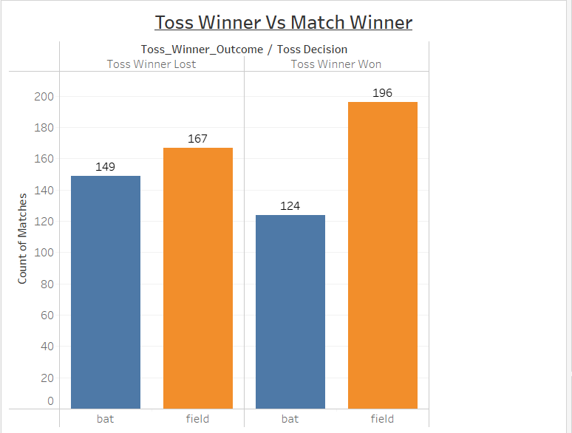
Match Statistics
Agenda
Introduction
Scope and Motivation
Details of Dataset
Key Points Covered
Visualization
Visualization
Insights:
It is observed that when opted for fielding, the number of wins is greater than the teams opted for batting.
Although same pattern is true for the teams who lost, but the times that the teams have won when choosing fielding is much higher than the times they lost when choosing fielding
06/07/23
IPL ANALYSIS

Slide 9
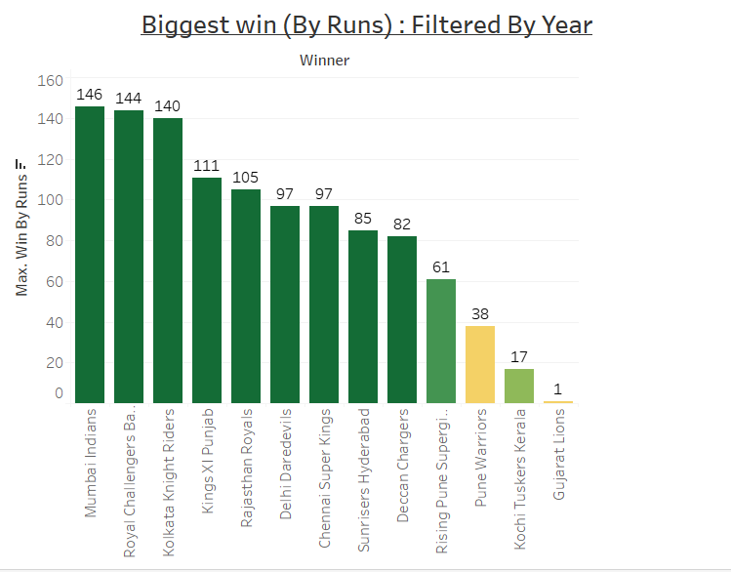
Match Statistics
Agenda
Introduction
Scope and Motivation
Details of Dataset
Key Points Covered
Visualization
Visualization
Insights:
Mumbai Indians, Royal Challengers and KKR are the teams that have the top three biggest wins by runs
Mumbai Indians having the biggest of the three.
Whereas Gujrat Lions has the smallest win.
06/07/23
IPL ANALYSIS

Slide 10
Agenda
Introduction
Scope and Motivation
Details of Dataset
Key Points Covered
Visualization
Visualization
Match Statistics key findings :
Royal Challengers Bangalore is performing very well having the highest totals, being on top three biggest wins by runs and also being on top three of biggest wins by wickets.
Where as Gujrat Lions is performing the least in the biggest win by wickets and runs.
The times of toss winner winning the game depending on the opted choice from batting or fielding follows the same pattern when losing the match. But the difference between choosing batting and fielding is significantly high when as most of the teams who won the toss and the game both have chosen fielding.
06/07/23
IPL ANALYSIS

Slide 11
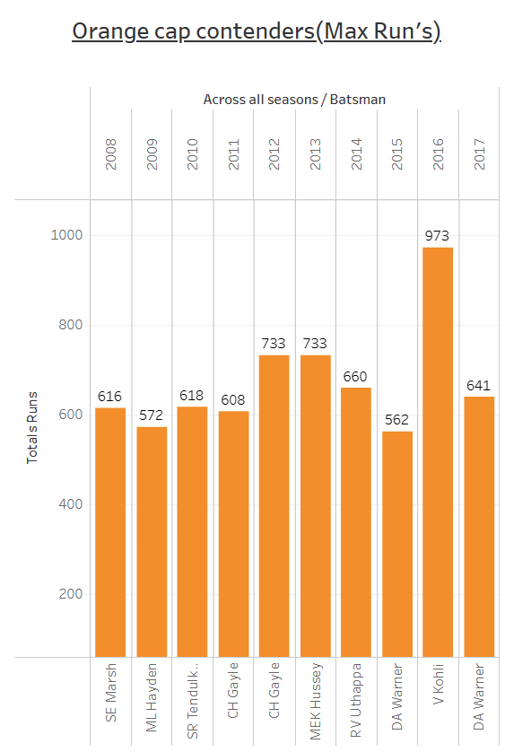
PLAYER Statistics
Agenda
Introduction
Scope and Motivation
Details of Dataset
Key Points Covered
Visualization
Visualization
Insights:
V kohli ,RV uthappa,MEK Hussey has been in leading when compared to other batsman.
06/07/23
IPL ANALYSIS

Slide 12
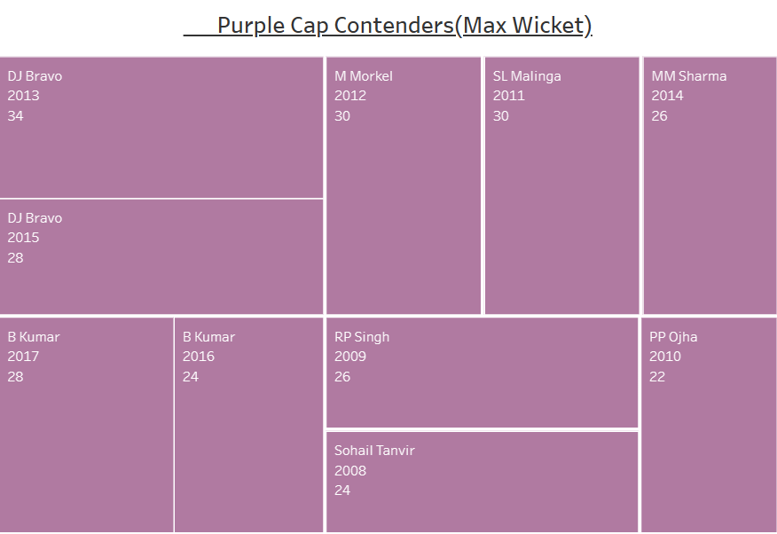
PLAYER Statistics
Agenda
Introduction
Scope and Motivation
Details of Dataset
Key Points Covered
Visualization
Visualization
Insights:
DJ Bravo ,B kumar were Top Purple Contenders in two seasons
DJ Bravo,SL Malinga had been always in Top Contenders
06/07/23
IPL ANALYSIS

Slide 13
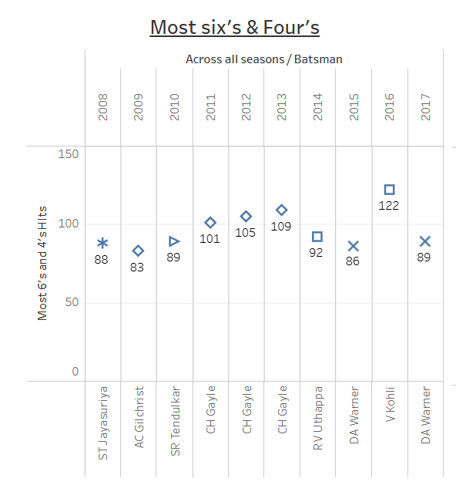
PLAYER Statistics
Agenda
Introduction
Scope and Motivation
Details of Dataset
Key Points Covered
Visualization
Visualization
Insights:
The batsman scored most six’s and four’s high in across all the seasons
But CH Gayle in top range ,because he have highest score in three seasons.
06/07/23
IPL ANALYSIS

Slide 14
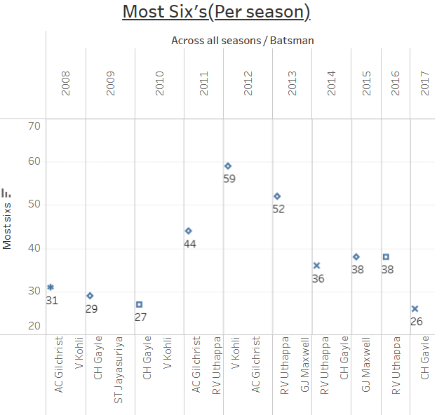
PLAYER Statistics
Agenda
Introduction
Scope and Motivation
Details of Dataset
Key Points Covered
Visualization
Visualization
Insights:
We can see here the bats man who scored most six’s (per season)
The CH Gayle scored three times six’s in 2009,2010,2017.
Also ,V Kohli have scored highest six’s than others.
06/07/23
IPL ANALYSIS

Slide 15
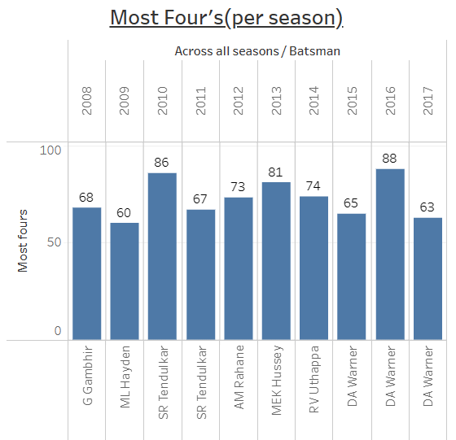
PLAYER Statistics
Agenda
Introduction
Scope and Motivation
Details of Dataset
Key Points Covered
Visualization
Visualization
Insights:
We can see here the bats man who scored most four’s (per season)
The DA warner had scored in three seasons
Also ,he only scored highest four’s’s than others.
06/07/23
IPL ANALYSIS

Slide 16
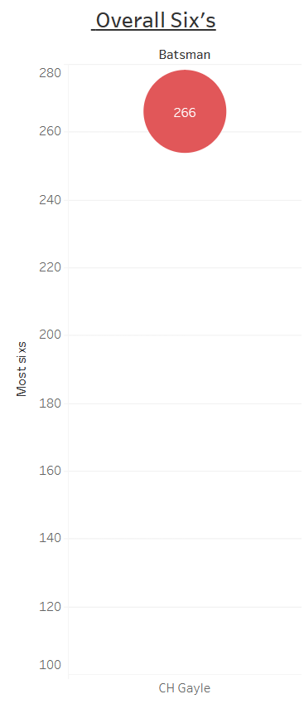
PLAYER Statistics
Agenda
Introduction
Scope and Motivation
Details of Dataset
Key Points Covered
Visualization
Visualization
Insights:
Overall six’s had scored by CH Gayle
He is the in the leading when compare to others.
06/07/23
IPL ANALYSIS

Slide 17
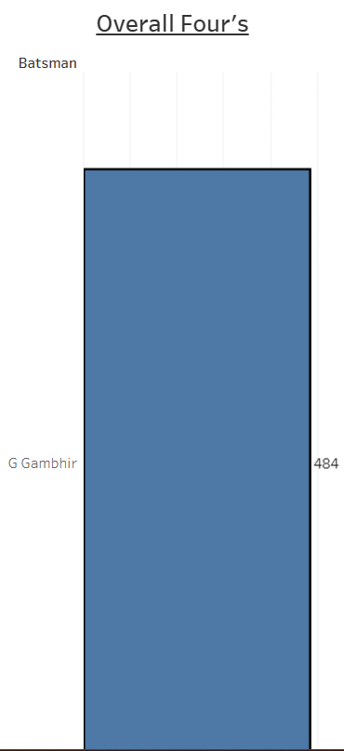
PLAYER Statistics
Agenda
Introduction
Scope and Motivation
Details of Dataset
Key Points Covered
Visualization
Visualization
Insights:
Overall four’s had scored by G Gambhir
He is in the leading
06/07/23
IPL ANALYSIS

Slide 18
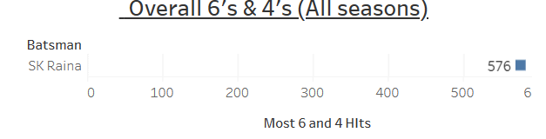
PLAYER Statistics
Agenda
Introduction
Scope and Motivation
Details of Dataset
Key Points Covered
Visualization
Visualization
Insights:
Overall 6’s & 4’s (All seasons)scored by SK Raina.He is in the topmost batsman
06/07/23
IPL ANALYSIS

Slide 19
Agenda
Introduction
Scope and Motivation
Details of Dataset
Key Points Covered
Visualization
Visualization
Player Statistics key findings :
Orange contenders took max runs in all the seasons(V Kohli, RV Uthappa, MEK Hussey has been in leading), as well as purple contenders too got max wickets in all the seasons(V Kohli,RV Uthappa, MEK Hussey has been in leading ).
CH Gayle got the most 6's & 4's in three seasons, other batsman scored one or two times a season.
Most 6's(Per season) CH Gayle is leading again and V Kohli. In the most 4's(per season) DA Warnier is leading, because he had scored in three seasons.
Overall 6's by CH Gayle(266), overall 4's by G Gambhir (484).overall 6's and 4's (All seasons) by SK Raina at the top.
06/07/23
IPL ANALYSIS

Slide 20
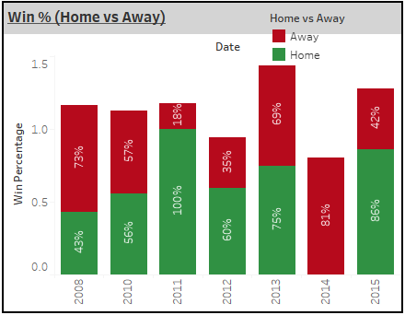
Team Statistics
Agenda
Introduction
Scope and Motivation
Details of Dataset
Key Points Covered
Visualization
Visualization
Insights:
It is varied result over the season but overall Home wins are always greater than Away wins.
So We can see in Season 2011 , 2013 and 2015 most of the wins are from Home.
06/07/23
IPL ANALYSIS

Slide 21
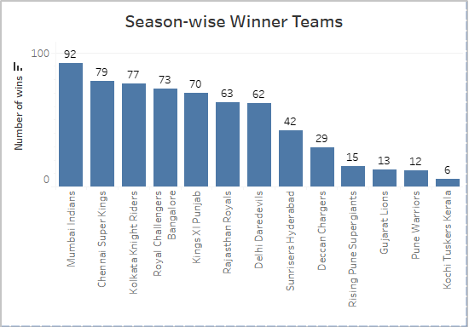
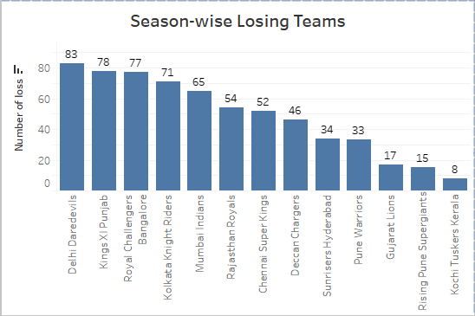
Team Statistics
Agenda
Introduction
Scope and Motivation
Details of Dataset
Key Points Covered
Visualization
Visualization
Insights:
Mumbai has been a constantly winning team over all the sesons where as Delhi Daredevils has been a losing one
Some of the teams such as RCB,KKR,RR has been giving performances 50-50.
06/07/23
IPL ANALYSIS

Slide 22
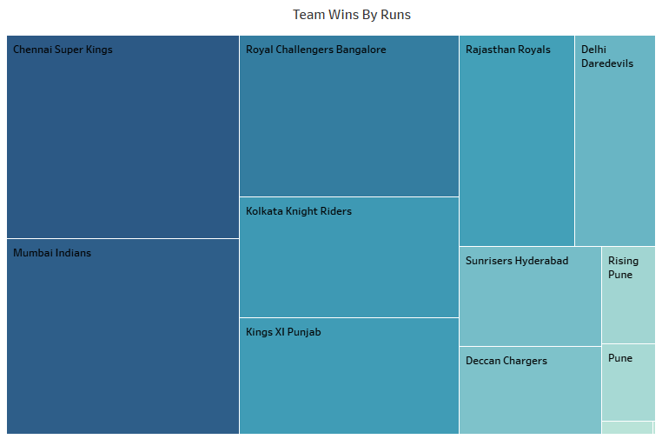
Team Statistics
Agenda
Introduction
Scope and Motivation
Details of Dataset
Key Points Covered
Visualization
Visualization
Insights:
Chennai Superkings, Mumbai Indians and Royal Challengers Banglore have been Top 3 Teams winning Matches by Runs
06/07/23
IPL ANALYSIS

Slide 23
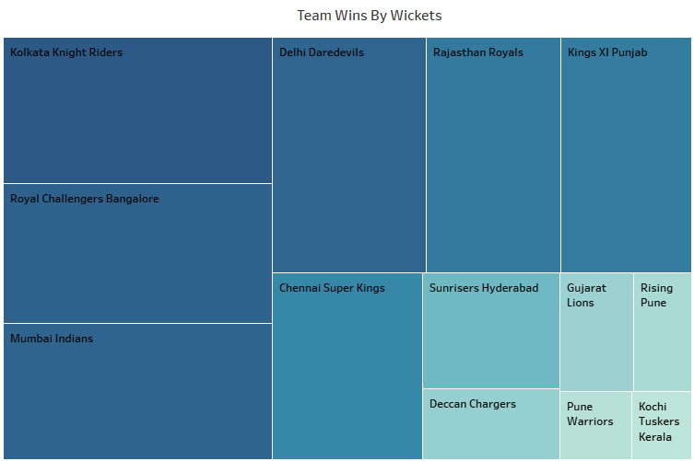
Team Statistics
Agenda
Introduction
Scope and Motivation
Details of Dataset
Key Points Covered
Visualization
Visualization
Insights:
KKR, Royal Challengers Banglore, Mumbai Indians have been Top 3 Teams winning Matches by Wickets
06/07/23
IPL ANALYSIS

Slide 24
Agenda
Introduction
Scope and Motivation
Details of Dataset
Key Points Covered
Visualization
Visualization
Team Statistics key findings :
It is varied result over the season but overall Home wins are always greater than Away wins.
So We can see in Season 2011 , 2013 and 2015 most of the wins are from Home.
Mumbai has been a constantly winning team over all the seasons where as Delhi Daredevils has been a losing one
Some of the teams such as RCB,KKR,RR has been giving performances 50-50.
Chennai Superkings, Mumbai Indians and Royal Challengers Bangalore have been Top 3 Teams winning Matches by Runs
KKR, Royal Challengers Bangalore, Mumbai Indians have been Top 3 Teams winning Matches by Wickets
06/07/23
IPL ANALYSIS

Slide 25
CONCLUSIONS
Totally 13 teams has participated in IPL History and few teams like: Pune Warriors, Kochi Tuskers Kerala, Rising Pune Supergiants, Gujarat Lions and Delhi Capitals has been only in 2 seasons and their success rate of is good when compared to other teams.
Mumbai Indians, Royal Challengers Bangalore and Chennai Super kings are best Defending teams.
Royal Challengers Bangalore, Mumbai Indians and Kolkata Knight Riders are the best Chasing teams.
From the year 2014 most of the teams are opting to field after winning toss and are also successful in winning the match.
Overall Chennai Super Kings and Mumbai Indians have high success rate and these two teams are the most successful teams as CSK has won 4 seasons and MI has won 3 seasons.

Slide 26
CONCLUSIONS
From the analysis, it was concluded that Chennai Super Kings and Mumbai Indians are more likely to win upcoming IPL seasons.
It is varied result over the season but overall Home wins are always greater than Away wins.
So We can see in Season 2011 , 2013 and 2015 most of the wins are from Home.
Mumbai has been a constantly winning team over all the seasons where as Delhi Daredevils has been a losing one
Some of the teams such as RCB,KKR,RR has been giving performances 50-50.
Chennai Superkings, Mumbai Indians and Royal Challengers Bangalore have been Top 3 Teams winning Matches by Runs
KKR, Royal Challengers Bangalore, Mumbai Indians have been Top 3 Teams winning Matches by Wickets

Slide 27
CONCLUSIONS
Thank You

